Slide 1


Modelling the covid-19 pandemic
An analysis of the efficacy of covid-19 related government measures
June 9, 2021
Gianluca Vanacore
Final Project
Programming for Quantitative Analysis
Prof. Ph.D. Arnau Valladares-Esteban
Swiss Institute for Empirical Economic Research

Slide 2
Research summary & agenda
Key Research Question: TO what extent is the persistence of covid-19 spread attributable to government quality?
The SIRF Model
Descriptive Statistics
Inferential Statistics
Parameter variation and estimation
The SIRF model builds on a parametric approach on the spread of the Covid-19 disease which allows to determine the development of the pandemic
Determining parameters are the effective contact rate, the recovery rate, and mortality rates
The development of susceptible, infected, recovered and fatal cases show high sensitivity towards parameter variation
The cross-section of Covid-19 statistics
Continents and countries experience the pandemic collectively but are hit with different intensity by re-occuring breakouts
Heavy Covid-19 outbreaks are not necessarily determined by geographical location
There must be other reasons that facilitate a strong and fast spread of the disease
Determinants of government efficacy
The ecological footprint increases, legislative size increases and political globalization decreases the efficacy of government interventions significantly
This significance is robust towards the introduction of continent fixed effects
Inheriting continent fixed effects and interactions the model shows a good fit (Adj. R2 of 0.608), however OLS assumptions might be violated
Key Insights
Inferential statistics on Covid-19 data requires the deployment of an epidemiological model as the prediction of cases based on government measures suffers from the reverse causality problem
Government quality is a determining factor for the efficacy of government interventions, nevertheless the simple regression models may violate the OLS assumptions
UNIVERSITY OF ST. GALLEN | Programming For Quantitative Analysis

Slide 3
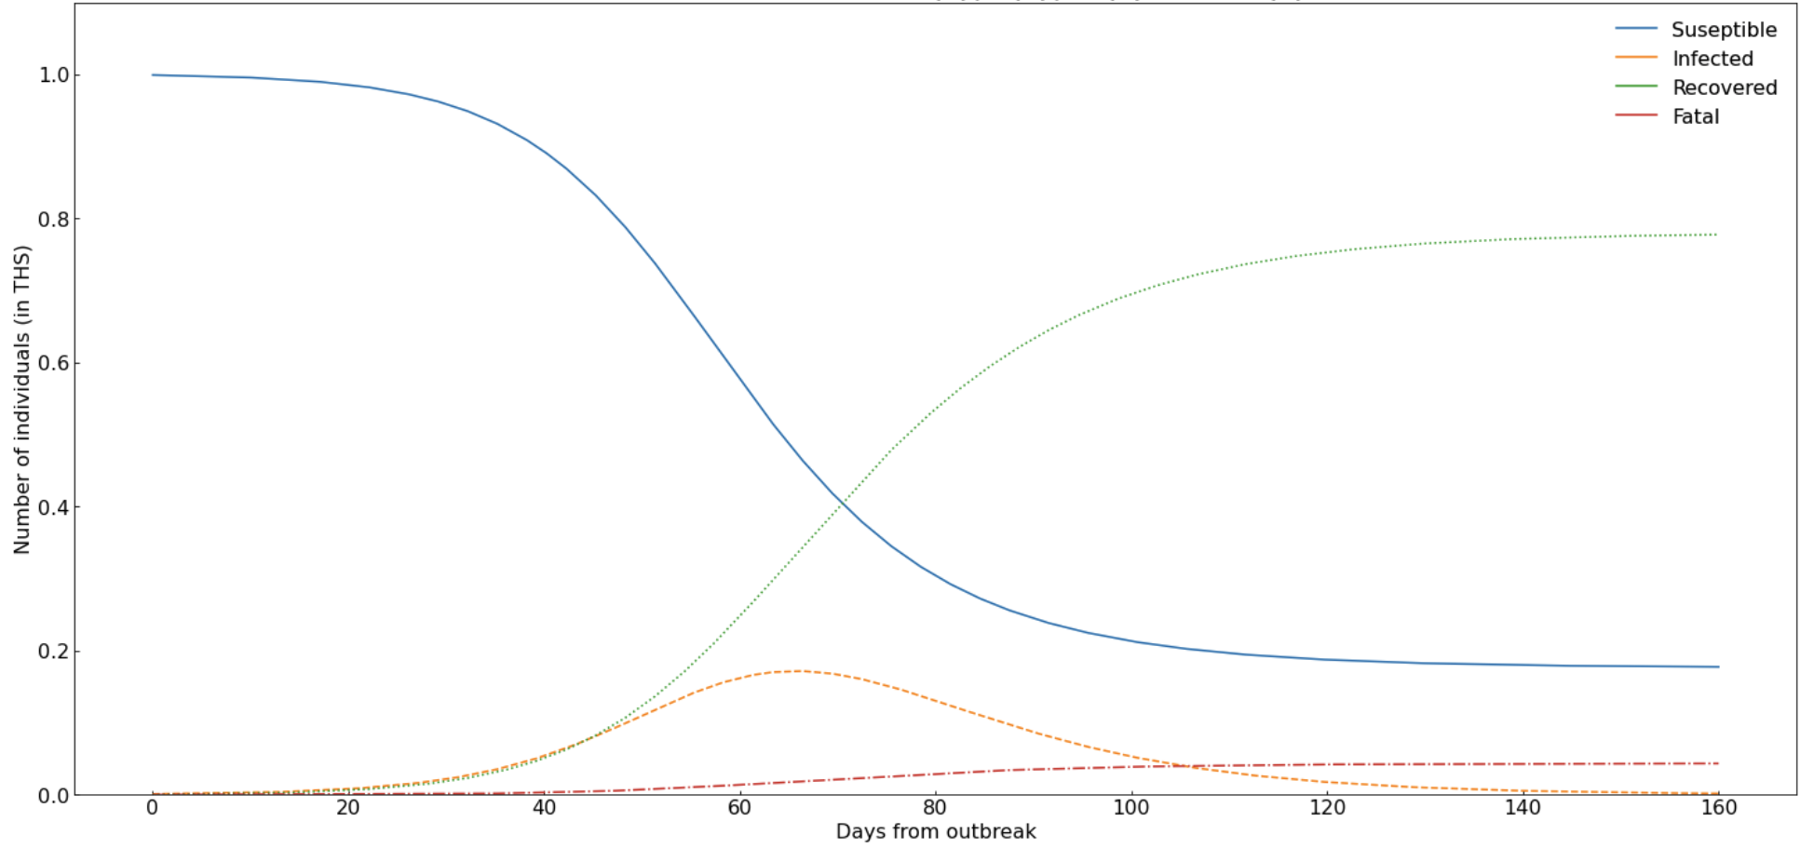
The SIRF Model

Slide 4
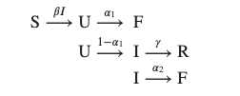
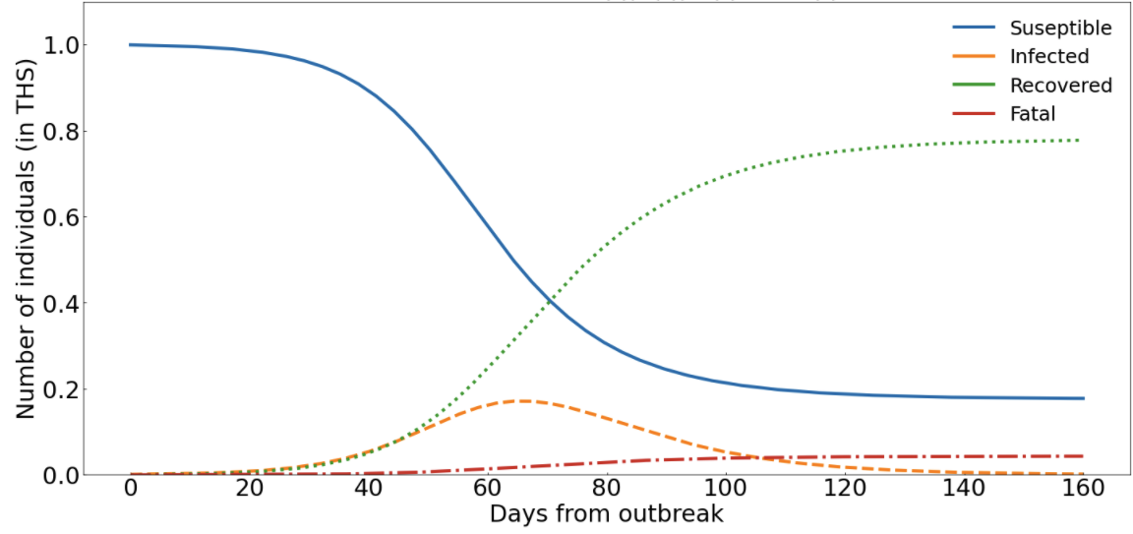
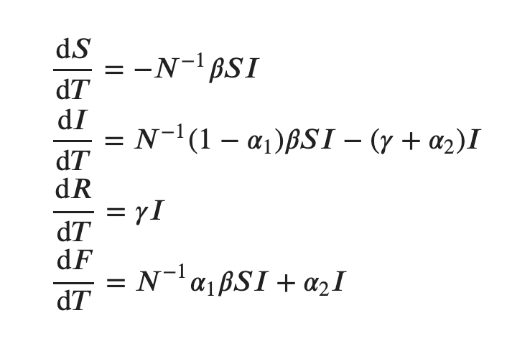
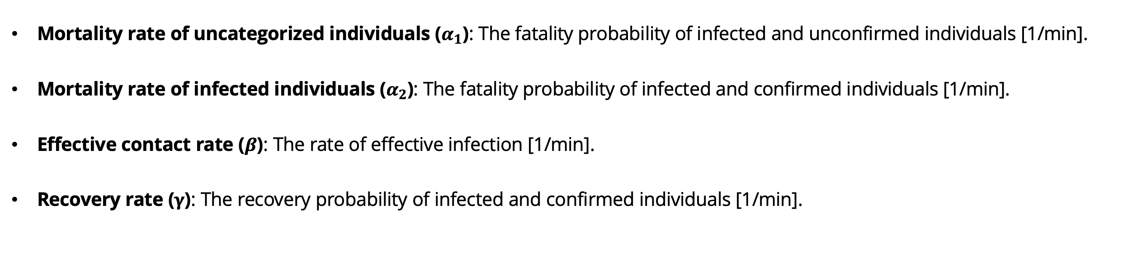
1
2
3
The SIRF Model
Compartmental states
The SIRF Model assigns individuals in a population to four mutually exclusive and collectively exhaustive states
Model Illustration
Determining Parameters
Mortality rate of uncategorized individuals ($α_{1}$): The fatality probability of infected and unconfirmed individuals [1/min].
Mortality rate of infected individuals ($α_{2}$): The fatality probability of infected and confirmed individuals [1/min].
Effective contact rate ($β$): The rate of effective infection [1/min].
Recovery rate ($γ$): The recovery probability of infected and confirmed individuals [1/min].
Determining Parameters
System of ODEs
UNIVERSITY OF ST. GALLEN | Programming For Quantitative Analysis

Slide 5
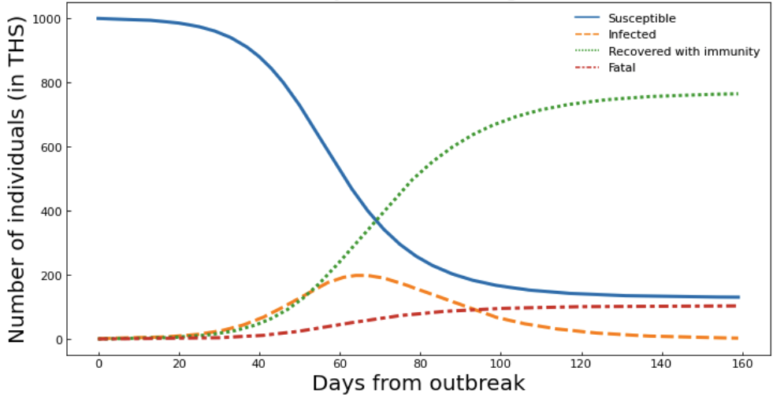
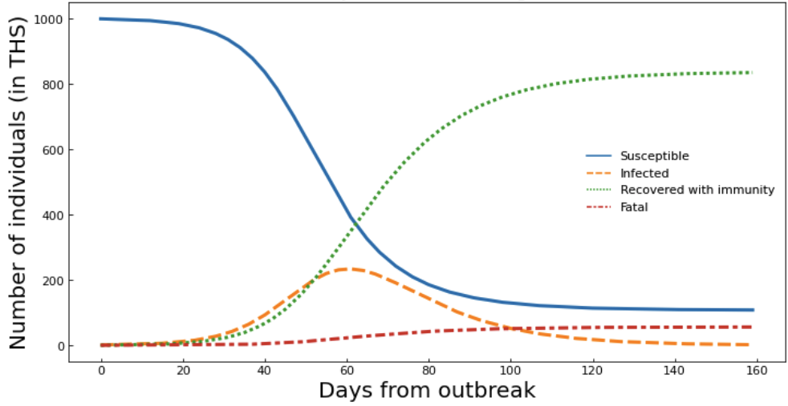
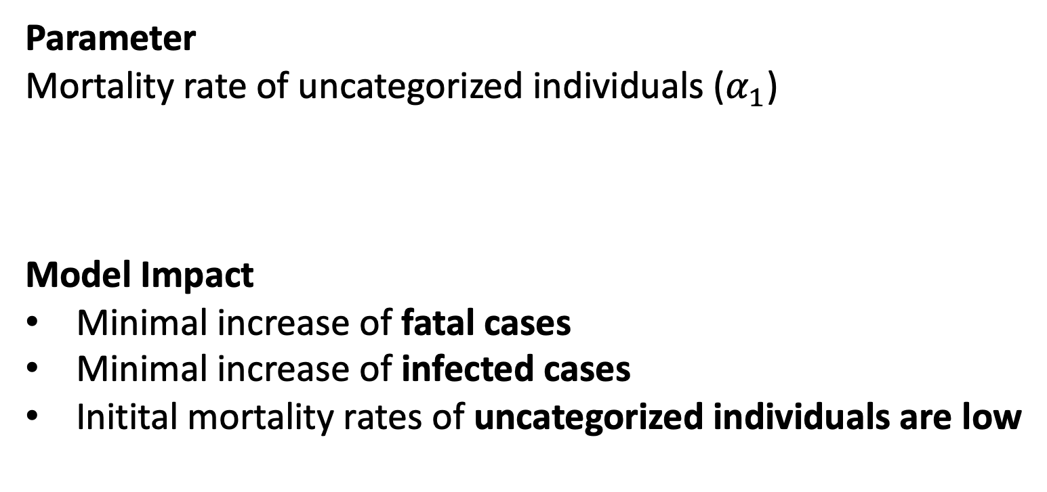
1
2
3
The SIRF Model
Parameter variation (1/4)
developments of susceptible, infected, recovered and fatal cases show high sensitivity towards parameter variation
Model Illustration
Alternative Scenario
Parameter Change
Parameter
Mortality rate of uncategorized individuals ($α_{1}$)
Model Impact
Minimal increase of fatal cases
Minimal increase of infected cases
Initital mortality rates of uncategorized individuals are low
Basis Scenario
UNIVERSITY OF ST. GALLEN | Programming For Quantitative Analysis

Slide 6
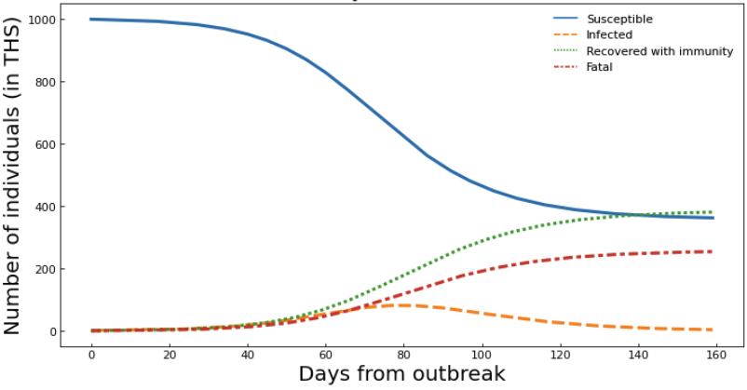
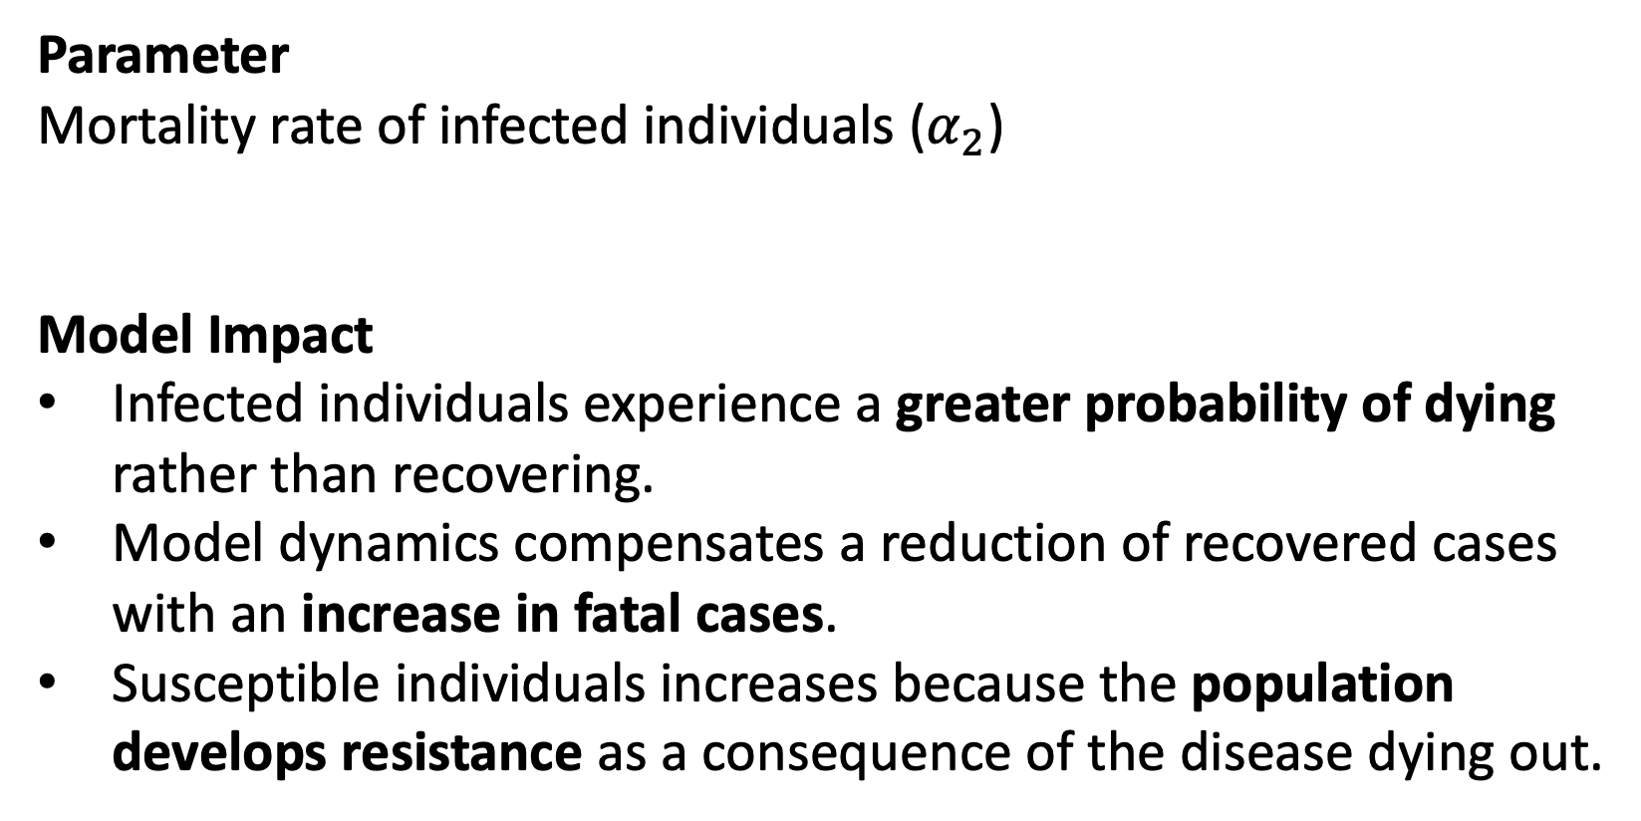
1
2
3
The SIRF Model
Parameter variation (2/4)
developments of susceptible, infected, recovered and fatal cases show high sensitivity towards parameter variation
Model Illustration
Alternative Scenario
Parameter Change
Parameter
Mortality rate of infected individuals ($α_{2}$)
Model Impact
Infected individuals experience a greater probability of dying rather than recovering.
Model dynamics compensates a reduction of recovered cases with an increase in fatal cases.
Susceptible individuals increases because the population develops resistance as a consequence of the disease dying out.
Basis Scenario
UNIVERSITY OF ST. GALLEN | Programming For Quantitative Analysis

Slide 7
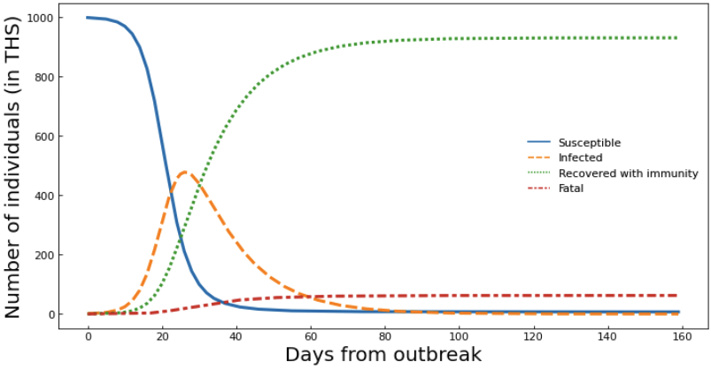
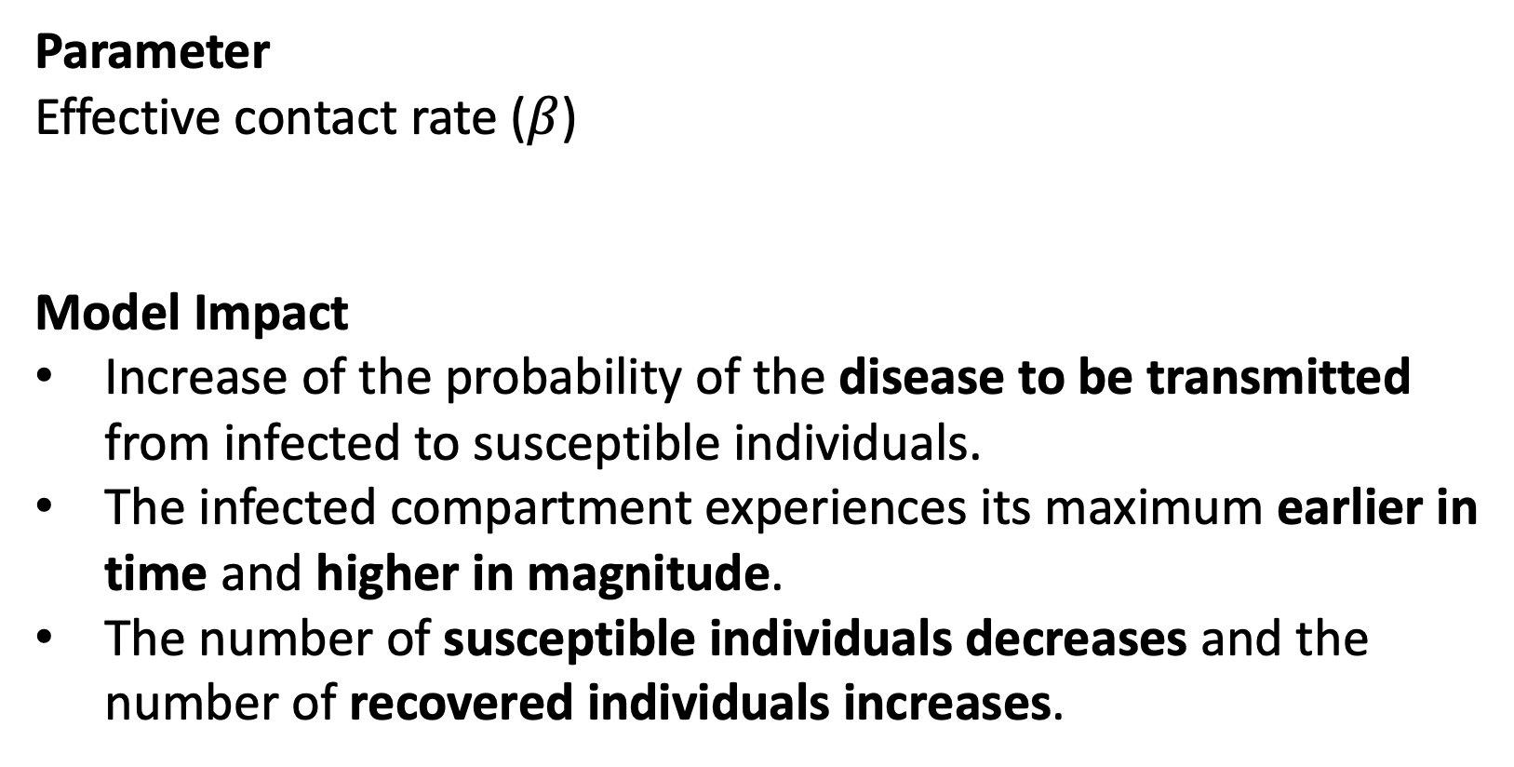
1
2
3
The SIRF Model
Parameter variation (3/4)
developments of susceptible, infected, recovered and fatal cases show high sensitivity towards parameter variation
Model Illustration
Alternative Scenario
Parameter Change
Parameter
Effective contact rate ($β$)
Model Impact
Increase of the probability of the disease to be transmitted from infected to susceptible individuals.
The infected compartment experiences its maximum earlier in time and higher in magnitude.
The number of susceptible individuals decreases and the number of recovered individuals increases.
Basis Scenario
UNIVERSITY OF ST. GALLEN | Programming For Quantitative Analysis

Slide 8
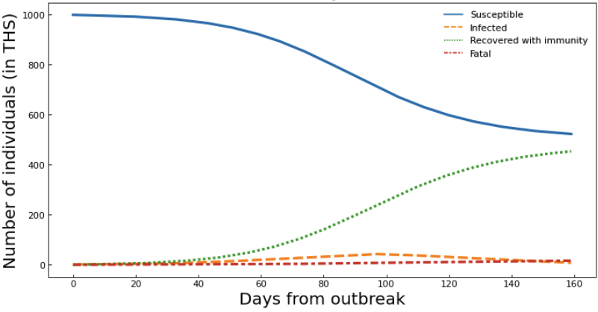
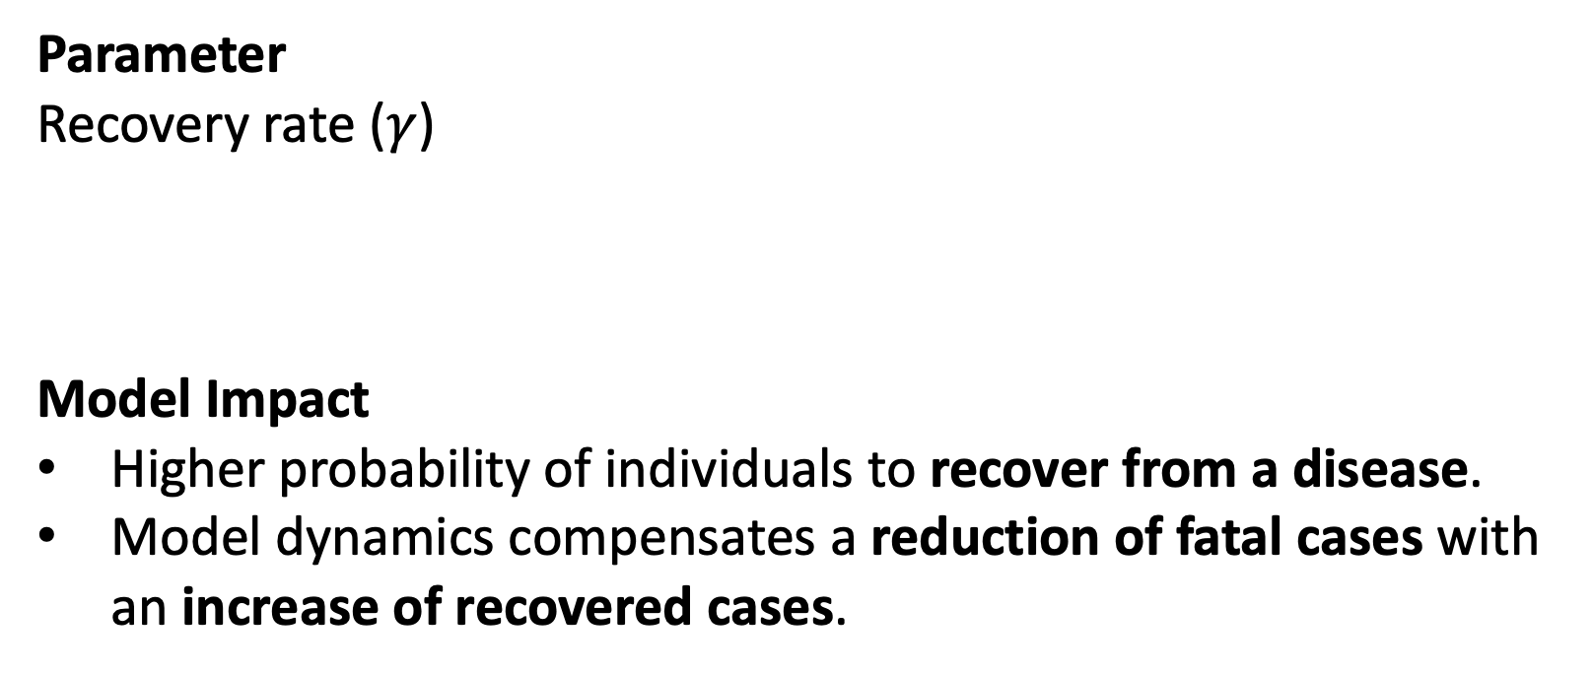
1
2
3
The SIRF Model
Parameter variation (4/4)
developments of susceptible, infected, recovered and fatal cases show high sensitivity towards parameter variation
Model Illustration
Alternative Scenario
Parameter Change
Parameter
Recovery rate ($γ$)
Model Impact
Higher probability of individuals to recover from a disease.
Model dynamics compensates a reduction of fatal cases with an increase of recovered cases.
Basis Scenario
UNIVERSITY OF ST. GALLEN | Programming For Quantitative Analysis

Slide 9
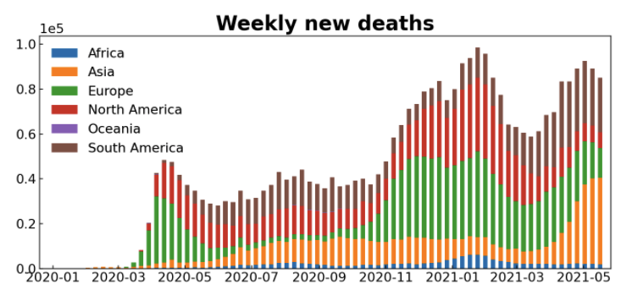
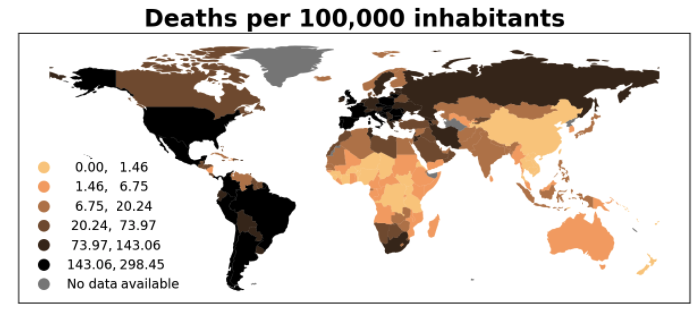
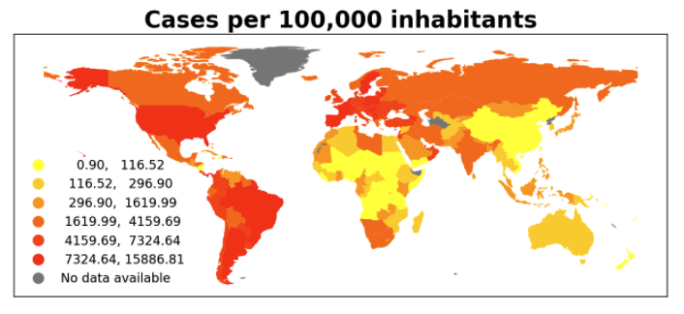
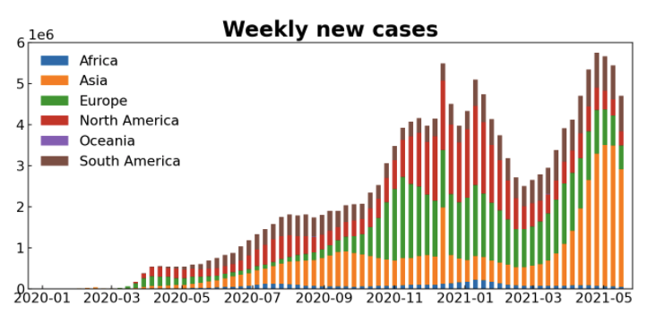
Descriptive Statistics

Slide 10
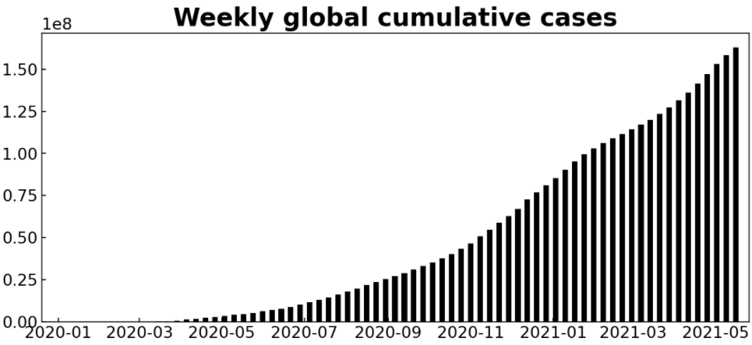
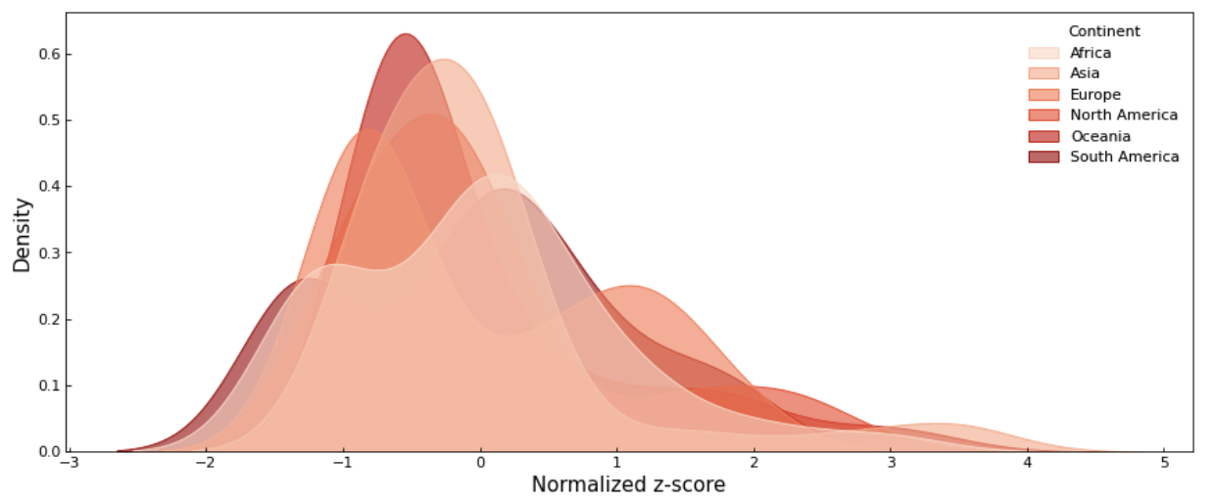
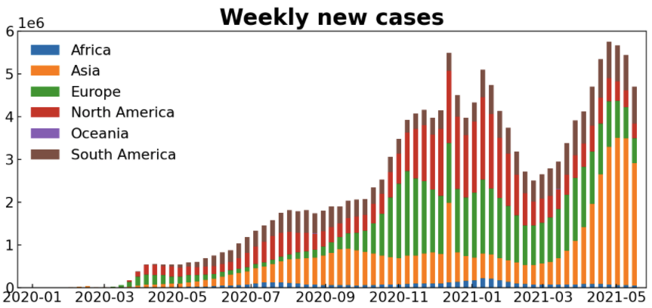
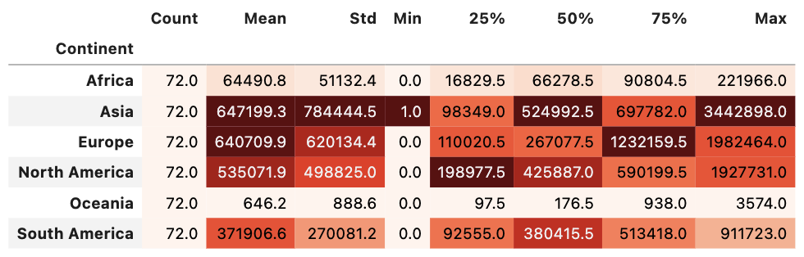
1
2
3
Descriptive Statistics
STATISTICS OF THE COVID-19 PANDEMIC – New CASES by continent
Continents experience breakouts of the covid-19 disease collectively but with large differences in intensity
Global Cumulative Cases
Distribution of New Cases
Global New Cases
UNIVERSITY OF ST. GALLEN | Programming For Quantitative Analysis
10

Slide 11
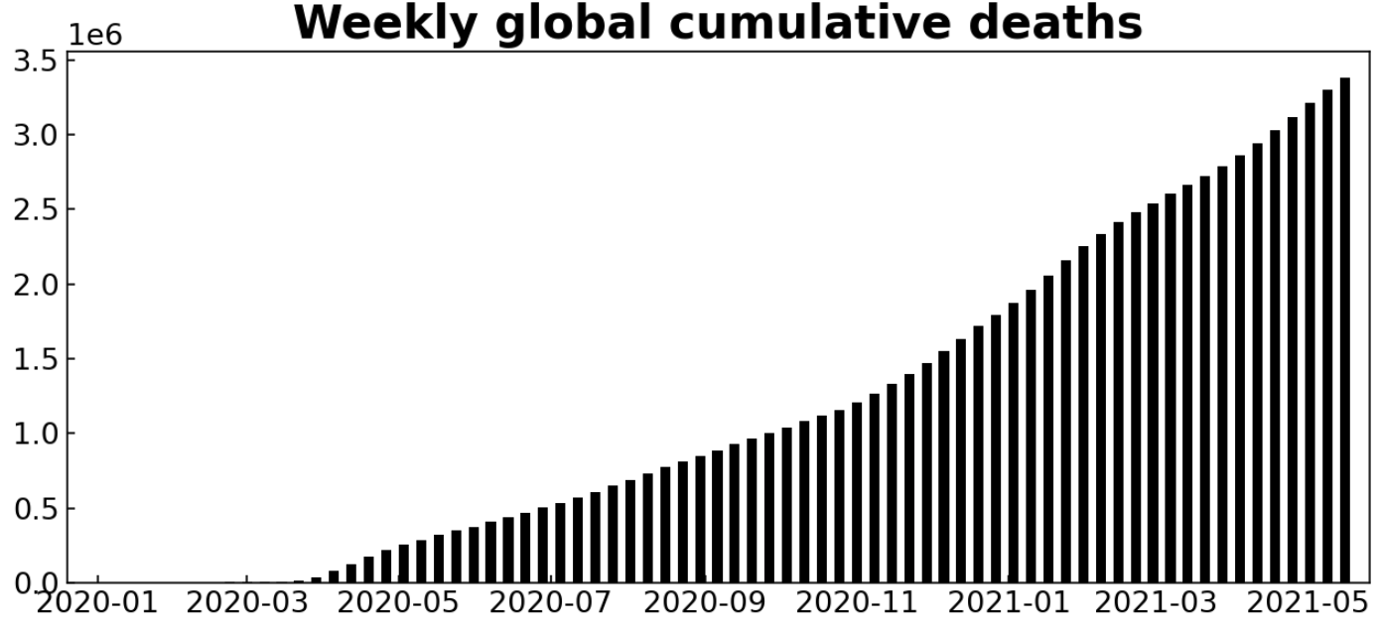
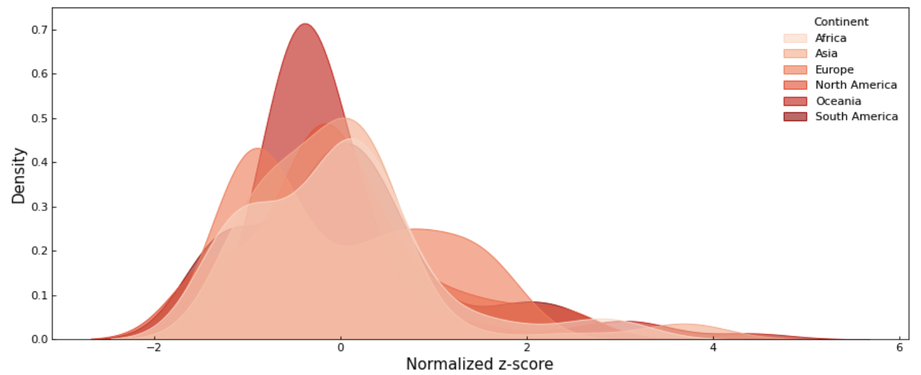
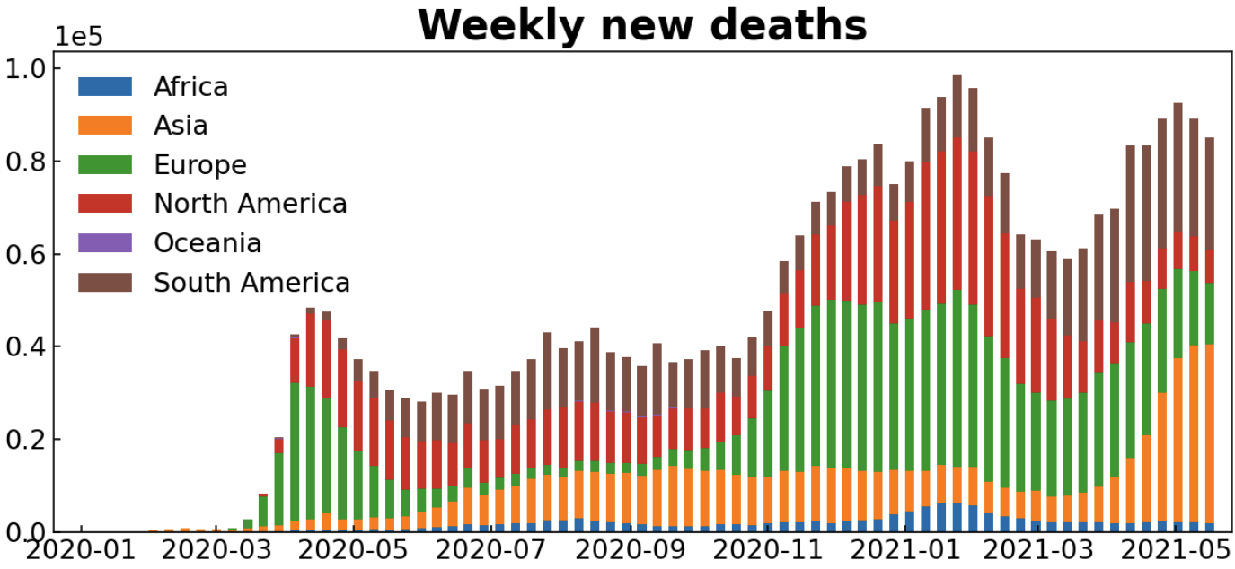
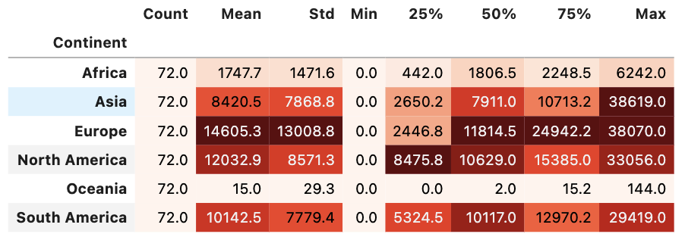
1
2
3
Descriptive Statistics
STATISTICS OF THE COVID-19 PANDEMIC – deaths by continent
Continents experience breakouts of the covid-19 disease collectively but with large differences in intensity
Global Cumulative Cases
Distribution of Deaths
Global New Cases
UNIVERSITY OF ST. GALLEN | Programming For Quantitative Analysis
11

Slide 12
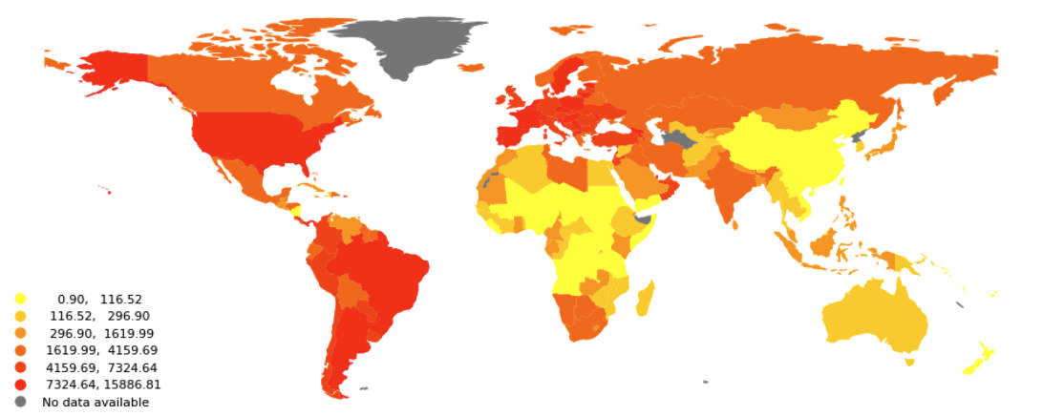
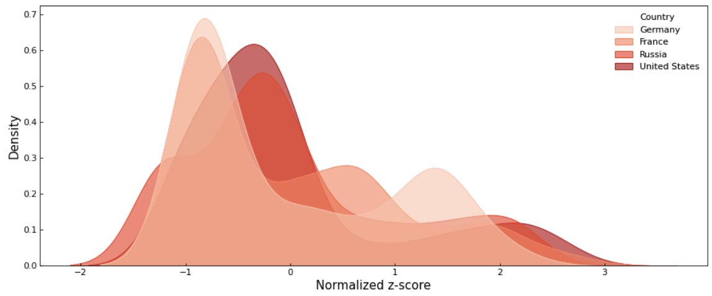
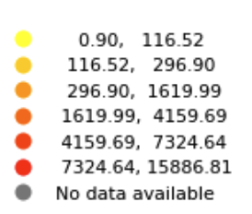
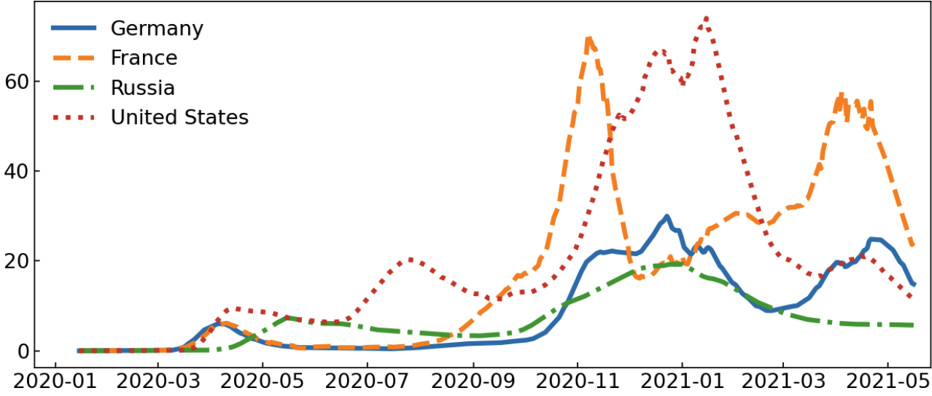
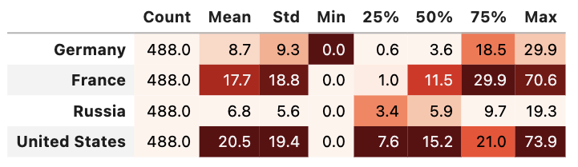
1
2
3
Descriptive Statistics
STATISTICS OF THE COVID-19 PANDEMIC – New CASES by country
Countries experience breakouts of the covid-19 disease collectively but with large differences in intensity
Cases per 100k Inhabitants
Distribution of Daily Cases
Daily Cases per 100k Inhabitants
UNIVERSITY OF ST. GALLEN | Programming For Quantitative Analysis
12

Slide 13
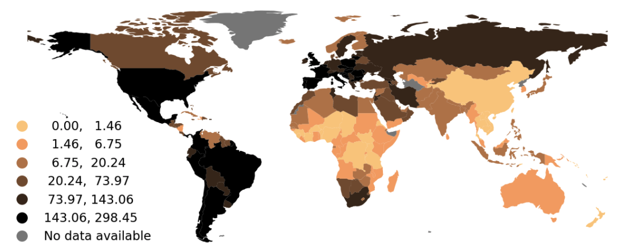
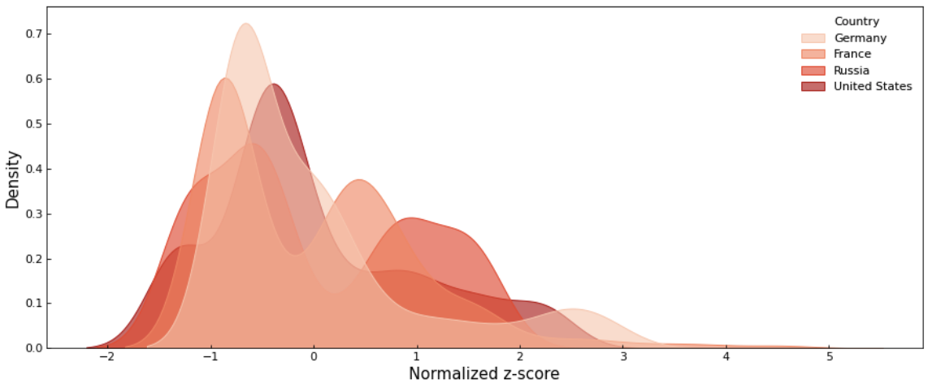
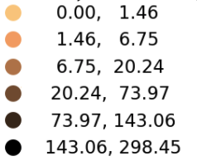

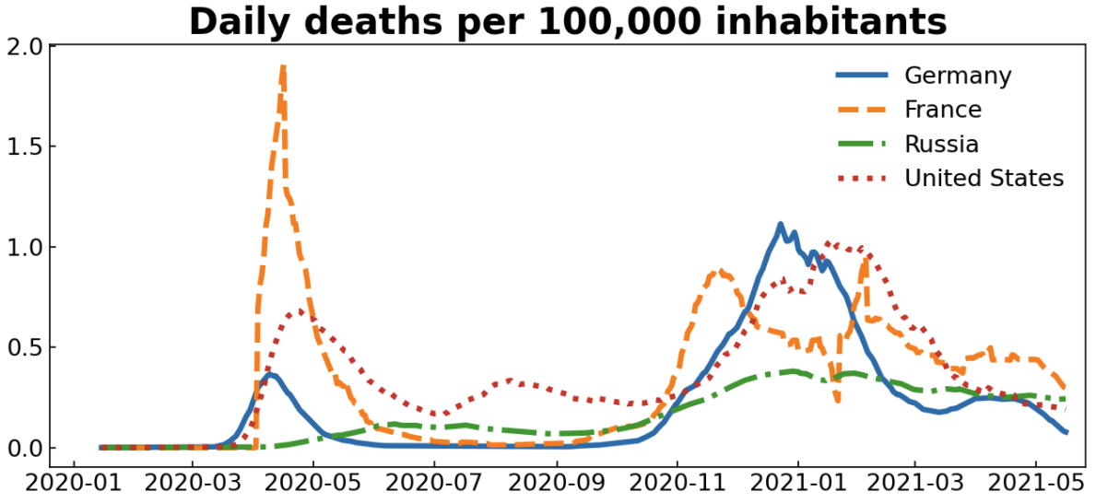
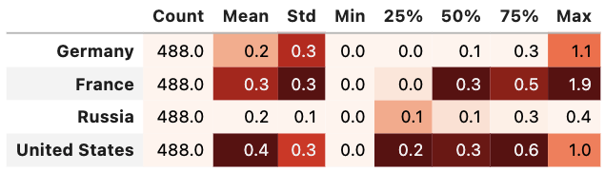
1
2
3
Descriptive Statistics
STATISTICS OF THE COVID-19 PANDEMIC – deaths by country
Countries experience breakouts of the covid-19 disease collectively but with large differences in intensity
Deaths per 100k Inhabitants
Distribution of Daily Cases
Daily Deaths per 100k Inhabitants
UNIVERSITY OF ST. GALLEN | Programming For Quantitative Analysis
13

Slide 14
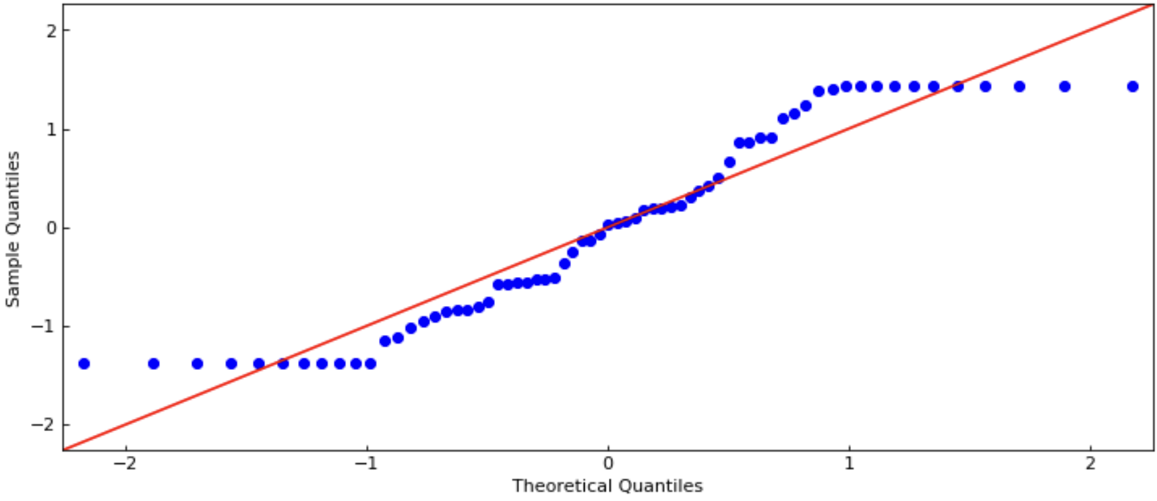
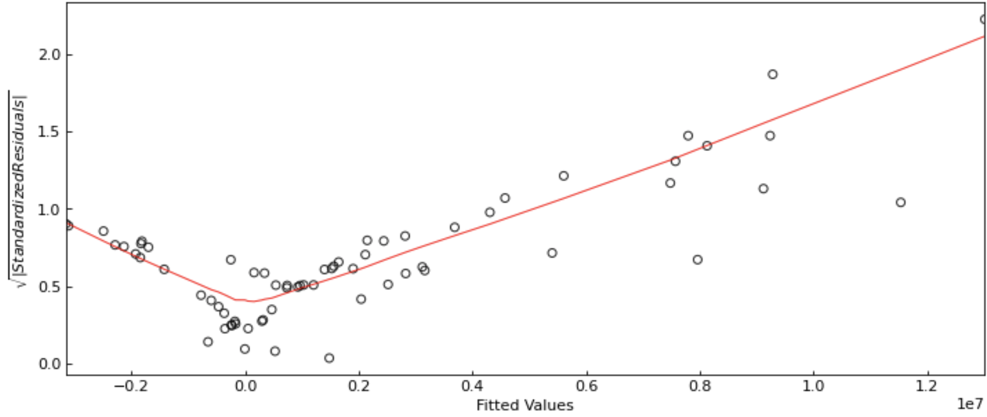
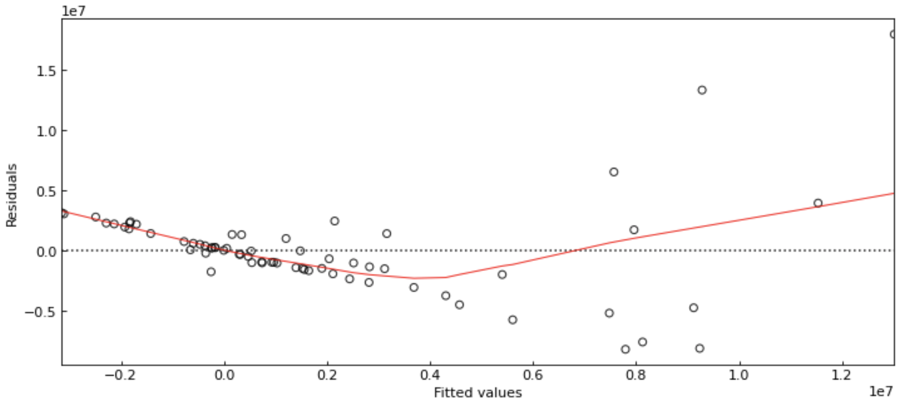
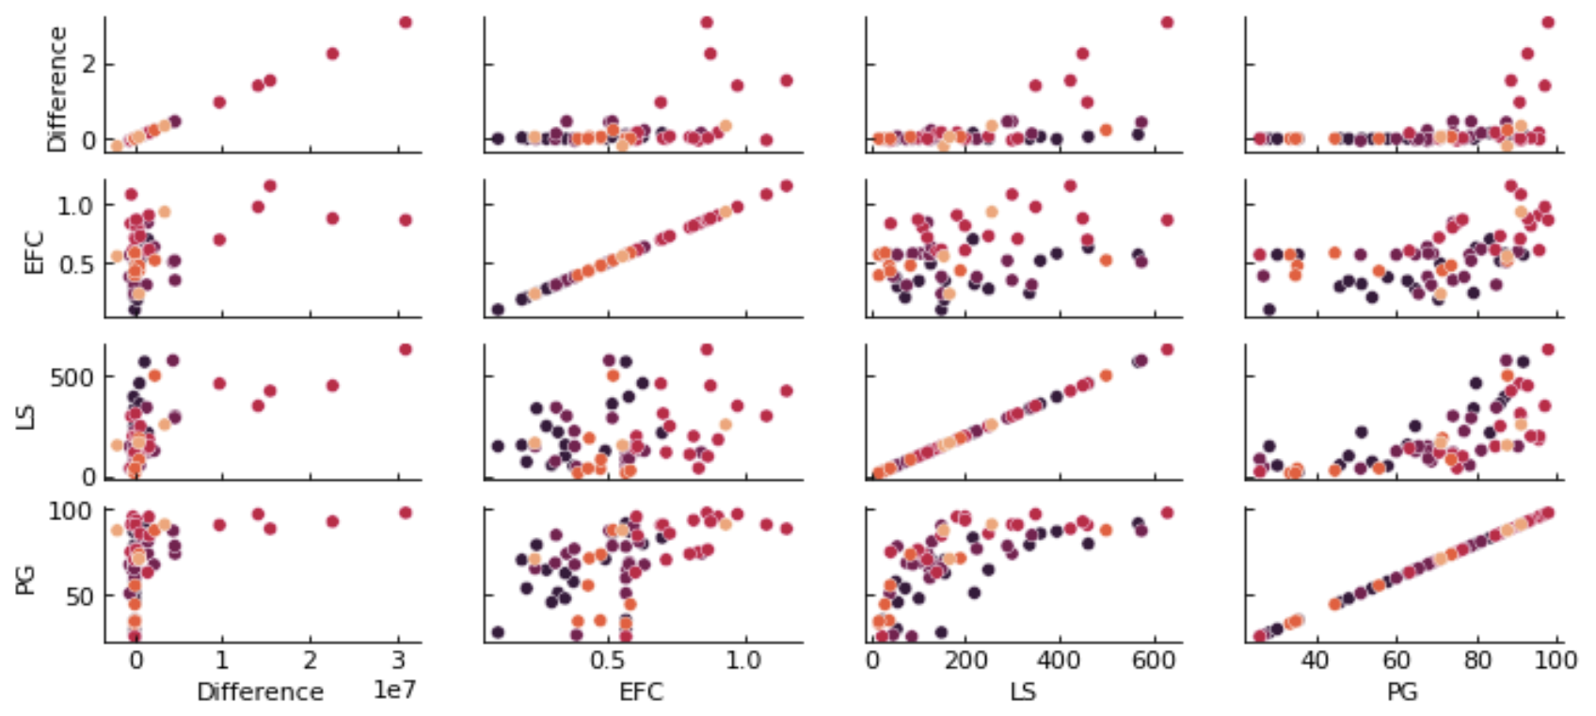
Normal Q-Q Plot
Scale-Location Test
Multicollinearity Test
Residuals-Fit Test
Inferential Statistics

Slide 15
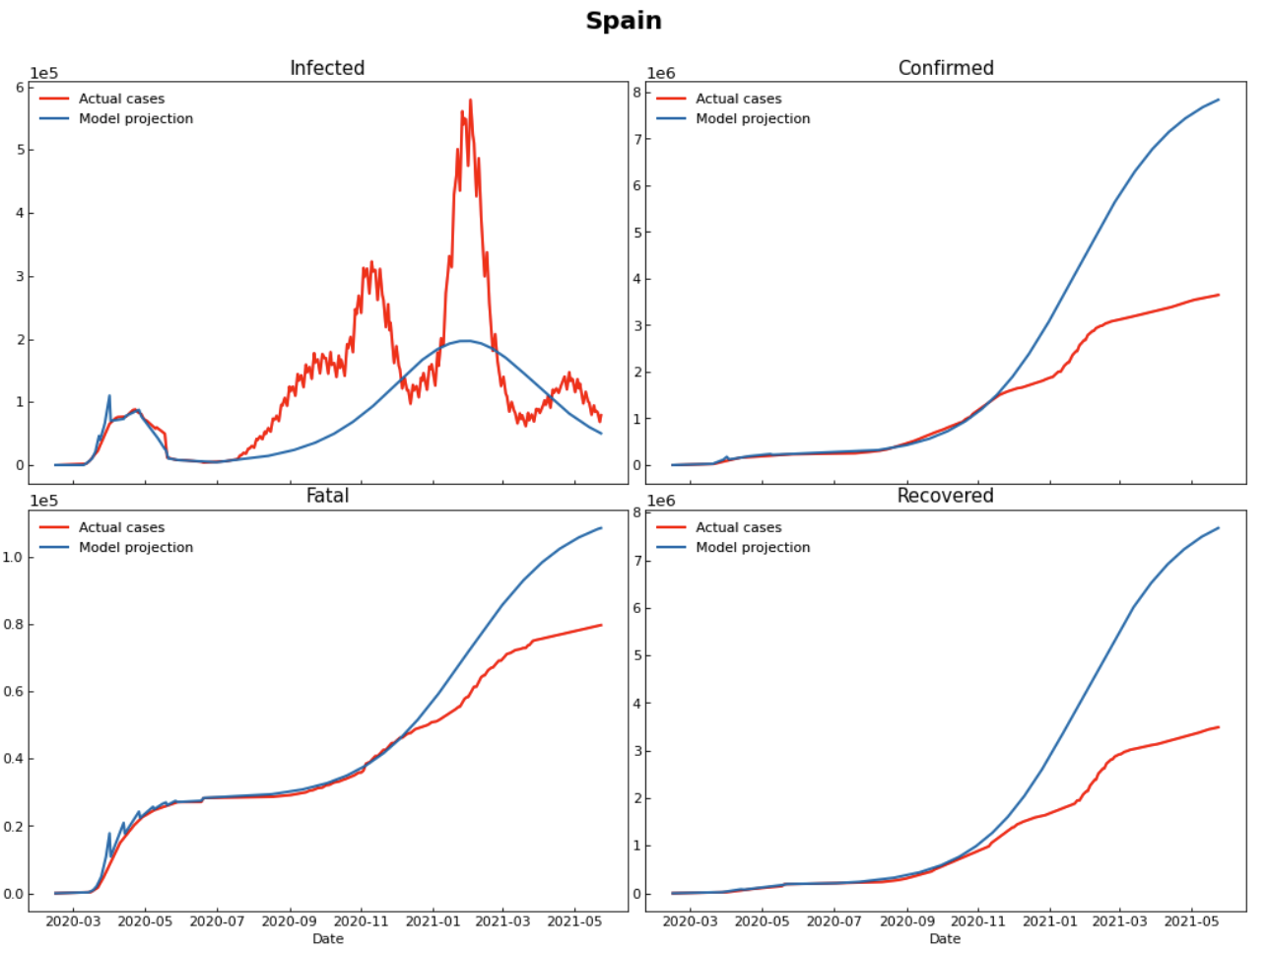
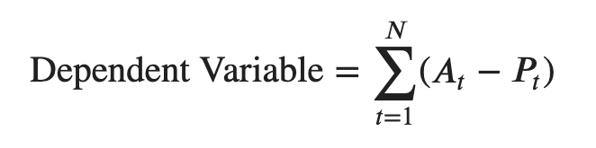
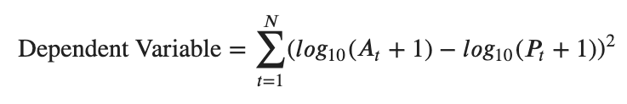
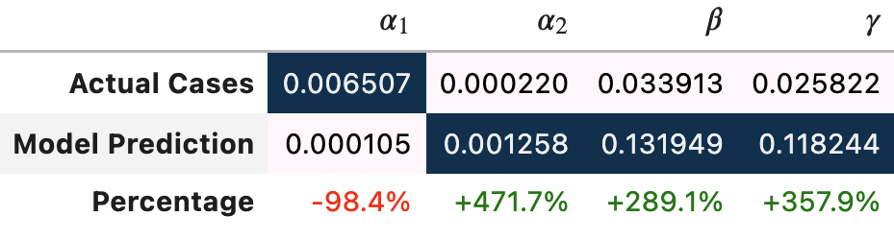
1
2
3
Inferential Statistics
Dependent Variable (1/4)
The dependent variable corresponds to the summed deviations of the prediction to actual cases
Variables of Interest
Illustration
Infected cases
Confirmed cases
Fatal cases
Recovered cases
Calculation Methods for Dependent Variable
UNIVERSITY OF ST. GALLEN | Programming For Quantitative Analysis

Slide 16
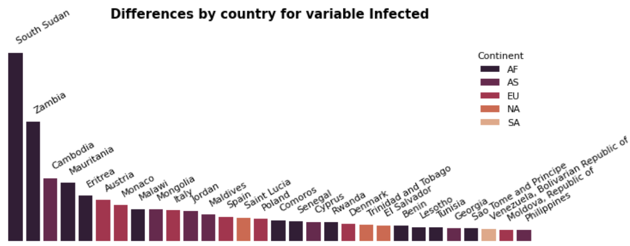
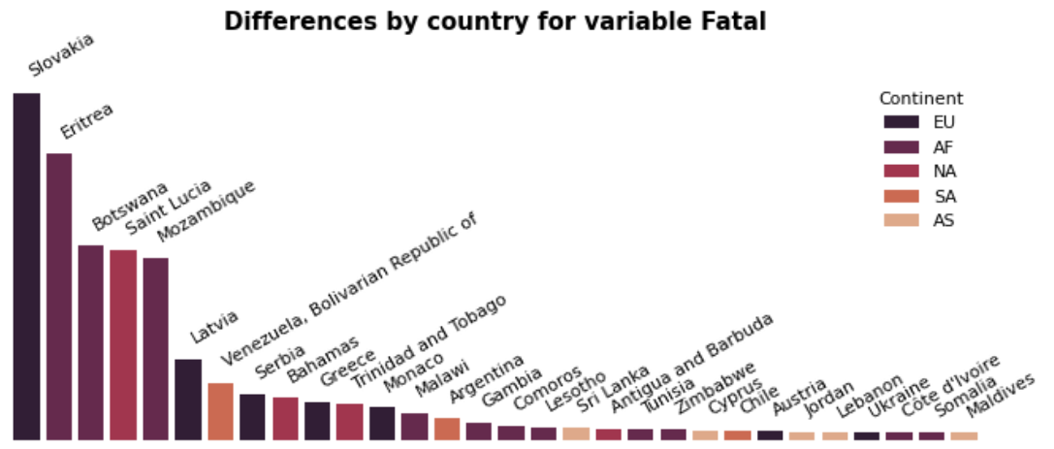
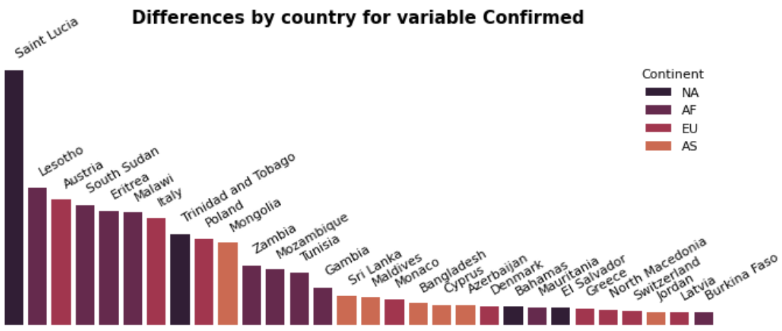
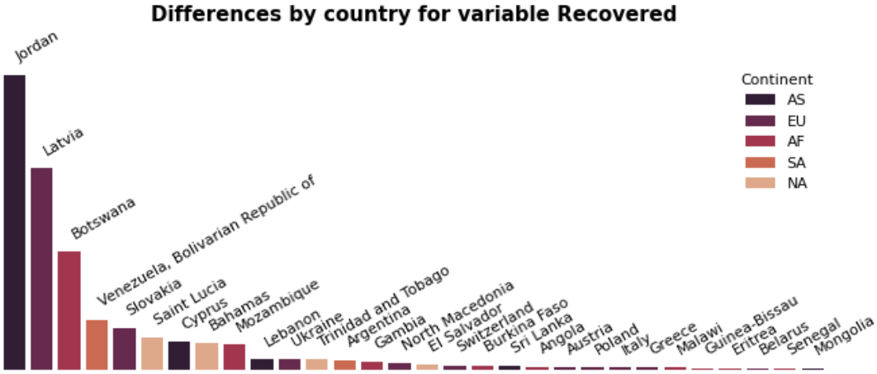
1
2
3
Inferential Statistics
Dependent Variable (2/4)
The distribution of the dependent variable shows great cross-country differences
Infected Cases
Fatal Cases
Confirmed Cases
Recovered Cases
UNIVERSITY OF ST. GALLEN | Programming For Quantitative Analysis

Slide 17
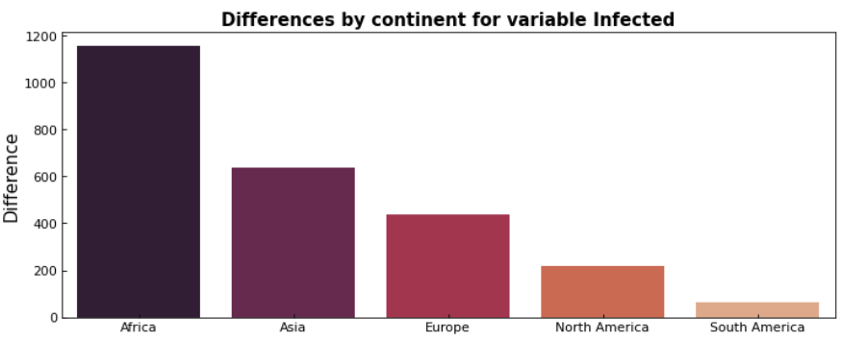
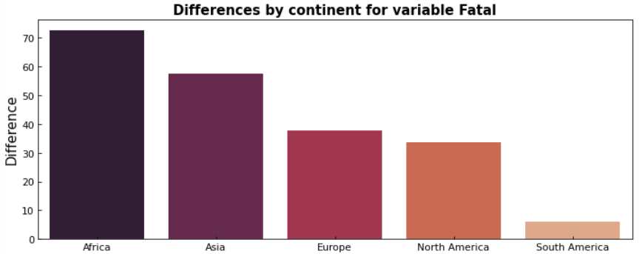


1
2
3
Inferential Statistics
Dependent Variable (3/4)
The distribution of the dependent variable shows great cross-continent differences
Infected Cases
Fatal Cases
Confirmed Cases
Recovered Cases
UNIVERSITY OF ST. GALLEN | Programming For Quantitative Analysis

Slide 18




1
2
3
Inferential Statistics
Dependent Variable (4/4)
The distribution of the dependent variable shows great cross-continent differences
Infected Cases
Fatal Cases
Confirmed Cases
Recovered Cases
UNIVERSITY OF ST. GALLEN | Programming For Quantitative Analysis

Slide 19


1
2
3
Inferential Statistics
Independent Variables (1/3)
Ecological footprint of consumption is a proxy for government quality
Assumption Statement
Citation
Ecological Footprint of Consumption as proxy for government quality
Joakim Kulin & Ingemar Johansson Sevä (2019)
The Role of Government in Protecting the Environment: Quality of Government and the Translation of Normative Views about Government Responsibility into Spending Preferences, International Journal of Sociology, 49:2, 110-129
DOI: 10.1080/00207659.2019.1582964
Scientific Evidence
Independent Variable (Regressor)
Cropland Footprint
Total global hectares per person of ecological footprint of cropland consumption
UNIVERSITY OF ST. GALLEN | Programming For Quantitative Analysis

Slide 20


1
2
3
Inferential Statistics
Independent Variables (2/3)
Legislative size is a proxy for government quality
Assumption Statement
Citation
Legislative Size as proxy for government quality
Britto, Diogo and Fiorin, Stefano (2016)
Corruption and Legislature Size: Evidence from Brazil. Available at SSRN: https://ssrn.com/abstract=2859940 or http://dx.doi.org/10.2139/ssrn.2859940
Scientific Evidence
Independent Variable (Regressor)
Legislative Size
Total number of directly elected representatives, excluding those appointed or indirectly elected.
UNIVERSITY OF ST. GALLEN | Programming For Quantitative Analysis

Slide 21



1
2
3
Inferential Statistics
Independent Variables (3/3)
Political globalization of consumption is a proxy for government quality
Assumption Statement
Citation
Political Globalization as proxy for government quality
Khan, H.A. (2017)
Globalization and the Quality of Government: an Analysis of the Relationship. Public Organiz Rev 17, 509–524 (2017). https://doi.org/10.1007/s11115-016-0352-4
Scientific Evidence
Independent Variable (Regressor)
Political Globalization
Scale of 1 to 100 measure with reference to the number of embassies and international non-governmental organisations (NGOs), along with participation in UN peacekeeping missions.
UNIVERSITY OF ST. GALLEN | Programming For Quantitative Analysis

Slide 22



1
2
3
Inferential Statistics
Multiple linear Regression (1/2)
Government quality variables are significant determinants for the efficacy of government interventions
Model Equation
Model evaluation
$${AD}_{t=150}^{v=I}=α+β_{1}EFC+β_{2}LS+β_{3}PG+ ε$$
Variable Description
${AD}_{t=150}^{v=I}=$ Absolute Difference for ’Infected’ over 150 time window
$EFC=$ Ecological Footprint Consumption [global hectares per person]
Regression summary
$LS=$ Legislative Size [number of elections]
$PG=$ Political Globalization [scale of 1 to 100]
UNIVERSITY OF ST. GALLEN | Programming For Quantitative Analysis

Slide 23

1
2
3
Inferential Statistics
Multiple linear Regression (2/2)
Regression diagnostics indicate a violation of ols assumptions
Normal Q-Q Plot
Scale-Location Test
Multicollinearity Test
Residuals-Fit Test
VIF
BP Test
9.26
4.38
14.45
UNIVERSITY OF ST. GALLEN | Programming For Quantitative Analysis

Slide 24





1
2
3
Inferential Statistics
Multiple linear Regression with continent fixed effects (1/2)
Government quality variables are significant determinants for the efficacy of government interventions
Model Equation
Model evaluation
$${AD}_{t=120}^{v=I}=α+β_{1}EFC+β_{2}LS+β_{3}PG+\sum_{i}{D_{i}+}ε$$
Variable Description
${AD}_{t=120}^{v=I}=$ Absolute Difference for ’Infected’ over 120 time window
$EFC=$ Ecological Footprint Consumption [global hectares per person]
Regression summary
$LS=$ Legislative Size [number of elections]
$PG=$ Political Globalization [scale of 1 to 100]
$D_{i}=$ Dummy Variable for $i$ = $\left\{\begin{matrix}AF: & Africa \\ AS: & Asia \\ \begin{aligned}EU: \\ NA: \\ SA:\end{aligned} & \begin{aligned}Europe \\ North America \\ South America\end{aligned}\end{matrix}\right.$
UNIVERSITY OF ST. GALLEN | Programming For Quantitative Analysis

Slide 25





1
2
3
Inferential Statistics
Multiple linear Regression with continent fixed effects (2/2)
Regression diagnostics indicate a violation of ols assumptions
Normal Q-Q Plot
Scale-Location Test
Multicollinearity Test
Residuals-Fit Test
VIF
BP Test
8.66
4.34
13.12
UNIVERSITY OF ST. GALLEN | Programming For Quantitative Analysis

Slide 26



1
2
3
Inferential Statistics
Multiple linear Regression with interaction effects (1/2)
Government quality variables are significant determinants for the efficacy of government interventions
Model Equation
Model evaluation
$${AD}_{t=120}^{v=I}=α+β_{1}PG+β_{2}EFCxLS+\sum_{i}{D_{i}+}ε$$
Variable Description
${AD}_{t=150}^{v=I}=$ Absolute Difference for ’Infected’ over 150 time window
$EFC=$ Ecological Footprint Consumption [global hectares per person]
Regression summary
$LS=$ Legislative Size [number of elections]
$PG=$ Political Globalization [scale of 1 to 100]
$D_{i}=$ Dummy Variable for $i$ = $\left\{\begin{matrix}AF: & Africa \\ AS: & Asia \\ \begin{aligned}EU: \\ NA: \\ SA:\end{aligned} & \begin{aligned}Europe \\ North America \\ South America\end{aligned}\end{matrix}\right.$
UNIVERSITY OF ST. GALLEN | Programming For Quantitative Analysis

Slide 27





1
2
3
Inferential Statistics
Multiple linear Regression with interaction effects (2/2)
Regression diagnostics indicate a violation of ols assumptions
Normal Q-Q Plot
Scale-Location Test
Multicollinearity Test
Residuals-Fit Test
VIF
BP Test
2.87
2.87
UNIVERSITY OF ST. GALLEN | Programming For Quantitative Analysis

Slide 28
End
Q&A Session
Modelling the covid-19 pandemic
An analysis of the efficacy of covid-19 related government measures
June 9, 2021
Gianluca Vanacore
Final Project
Programming for Quantitative Analysis
Prof. Ph.D. Arnau Valladares-Esteban
Swiss Institute for Empirical Economic Research

